Slide 1
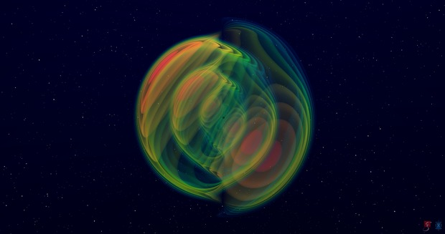


Methods for Multi-source Resolution in Pulsar Timing Array Based Gravitational Wave Detection
Yiqian Qian
Soumya D. Mohanty
Yan Wang
2021/02/26

Slide 2
Outline
Introduction
1
Pulsar Timing Arrays
Methods
2
xMBLT & iMBLT
Results
3
Simulation Configuration
Summary & Conclusion
4
Computational cost
A combination of two to enable multi-source detection
Ground-based and space-based detectors
Future instruments
Results so far
MaxPhase & AvPhase
Motivation

Slide 3
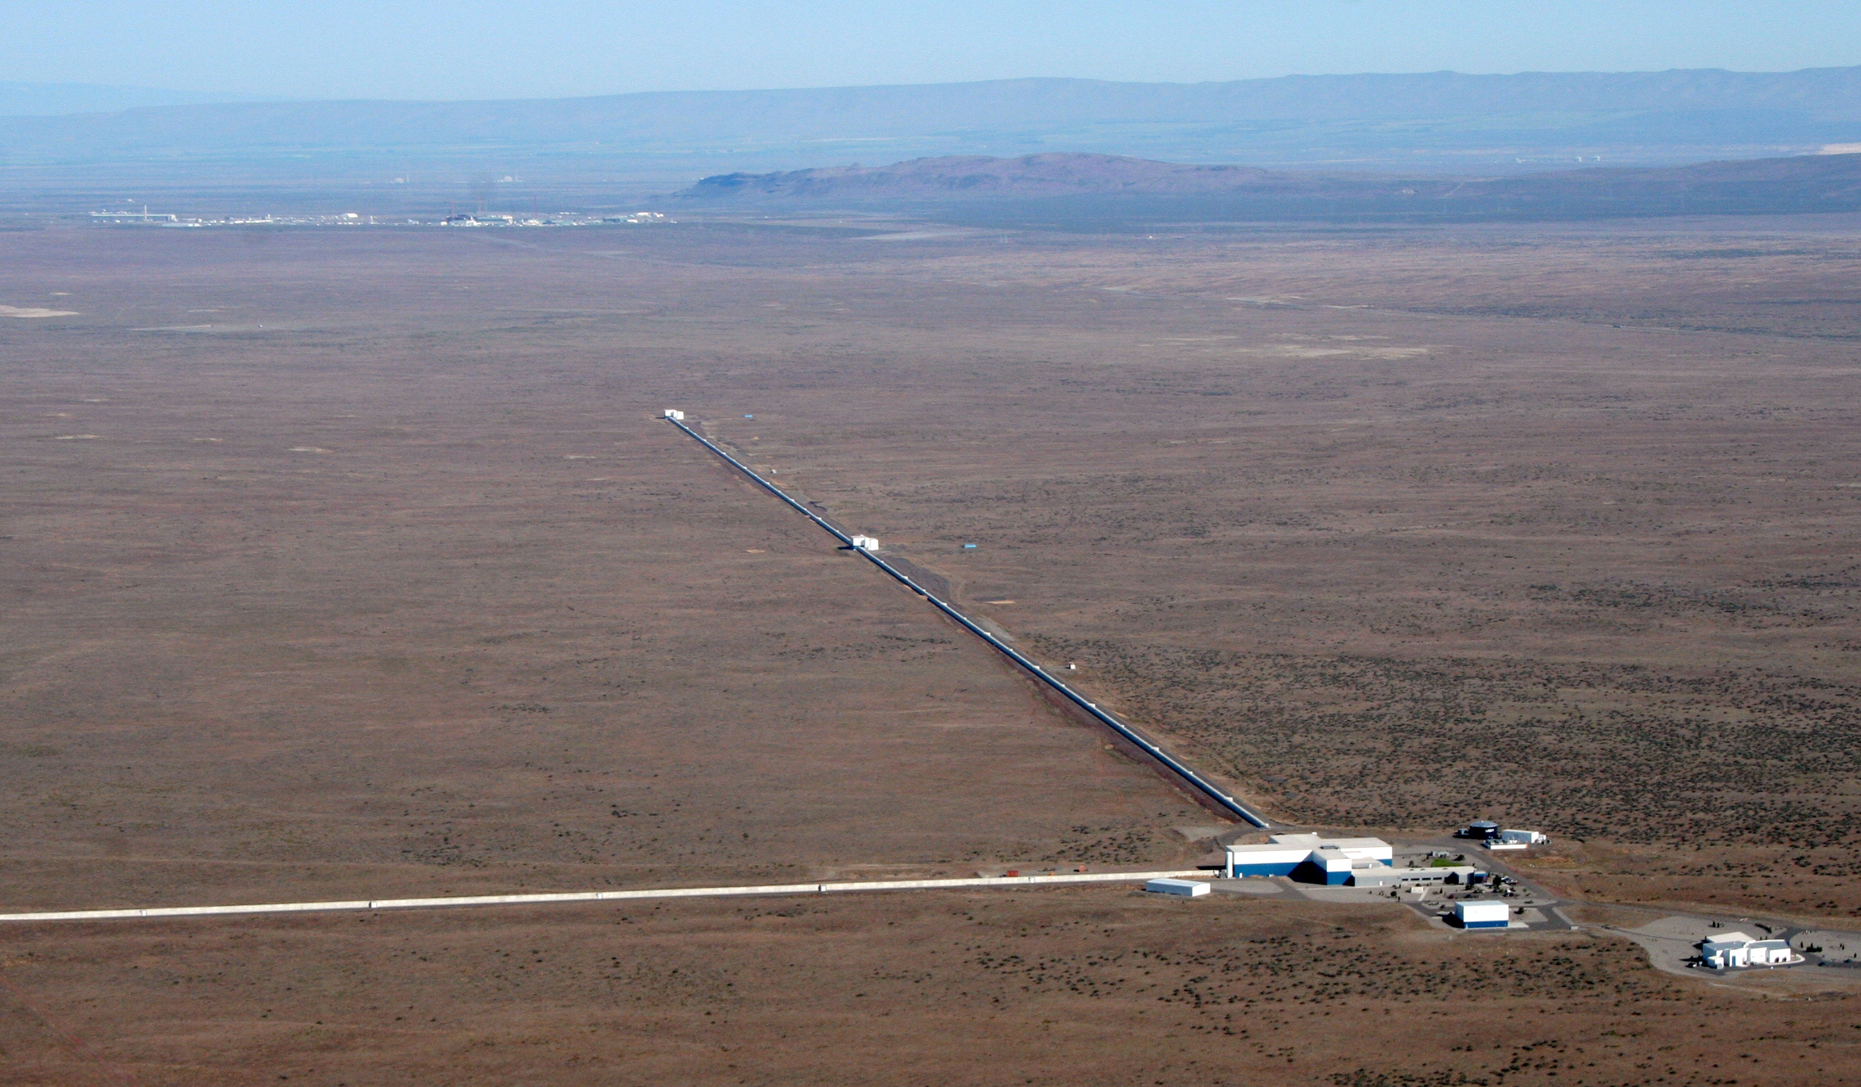
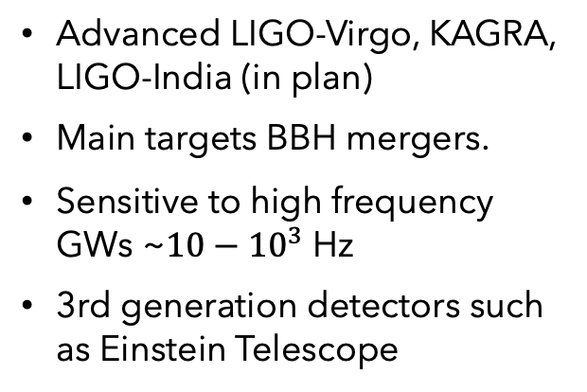
Ground-based Detectors
Discoveries
GW150914 (First detection)
GW170817 (First binary neutron star detection)
GW190412 (Cover)
Full event list https://www.ligo.org/detections.php
Advanced LIGO-Virgo, KAGRA, LIGO-India (in plan)
Main targets BBH mergers.
Sensitive to high frequency GWs ~$10−{10}^{3}$ Hz
3rd generation detectors such as Einstein Telescope

Slide 4
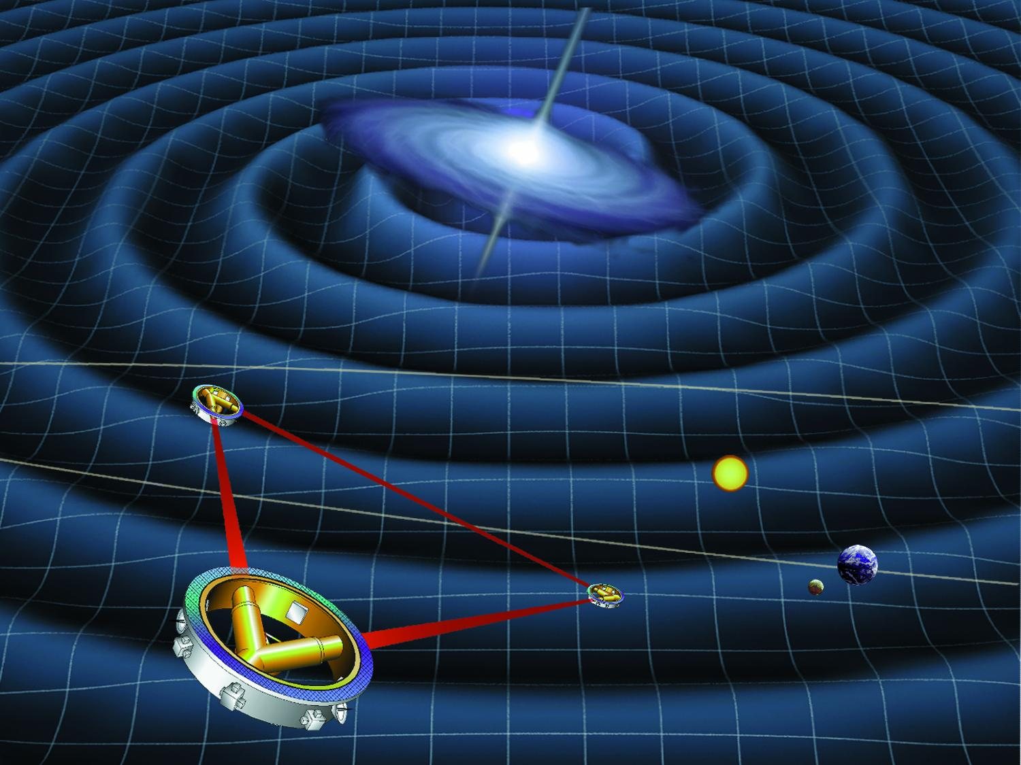
Space-based Detectors
Laser Interferometer Space Antenna (LISA)
LISA path finder (not a detector, meant to test key technologies needed for LISA)
DECIGO
Tian Qin, smaller armlengths +geocentric
Taiji, LISA-scale, heliocentric
Sensitivity ~0.1mHz~1Hz

Slide 5
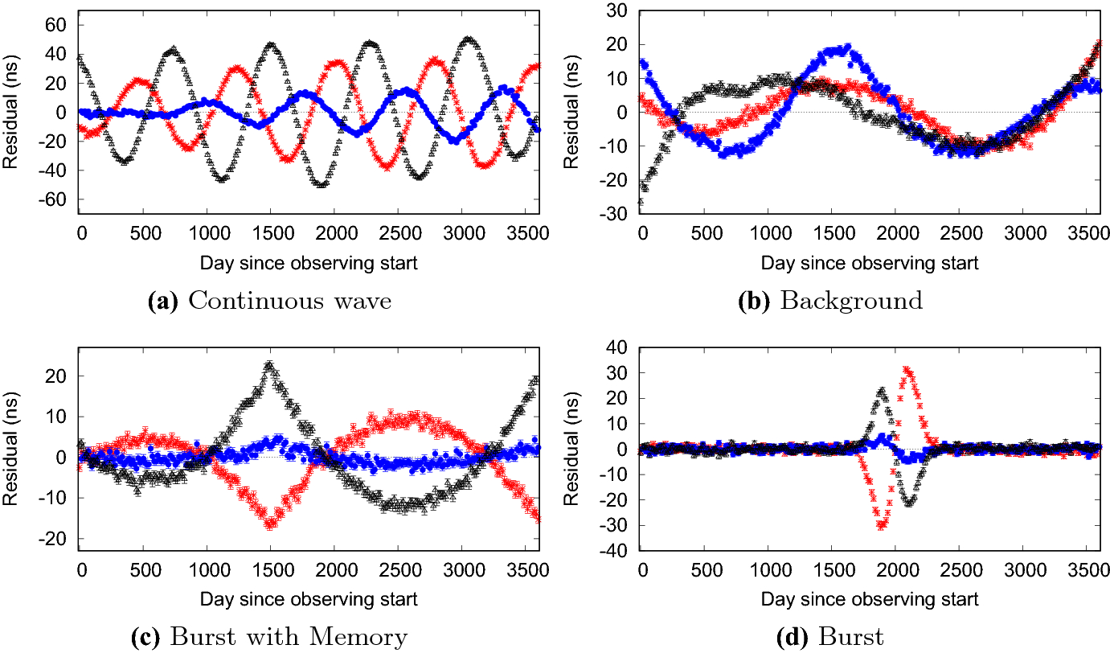
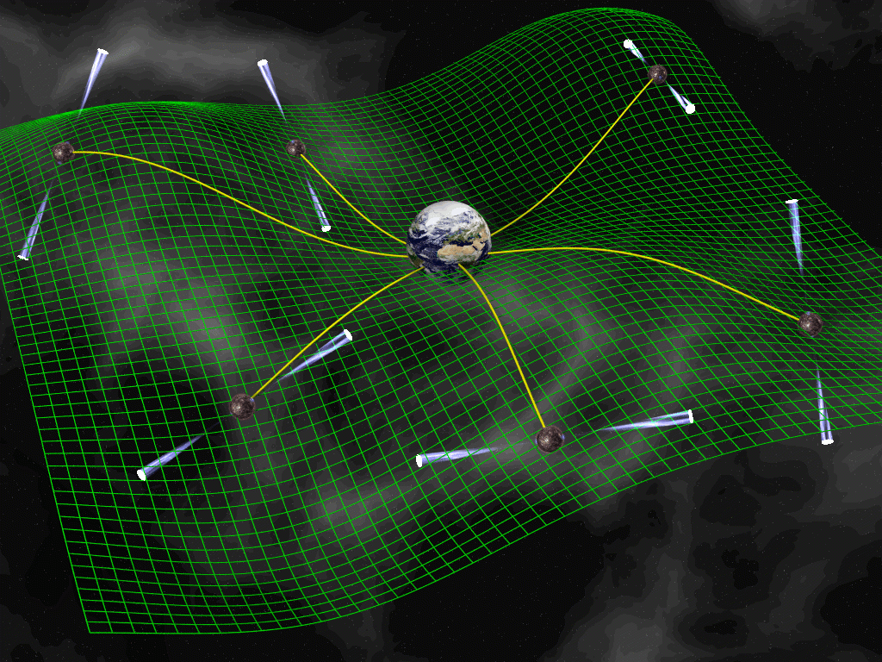
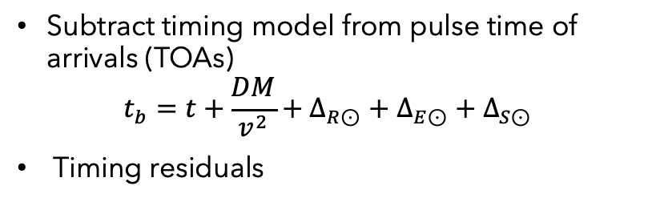
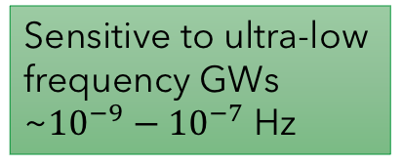
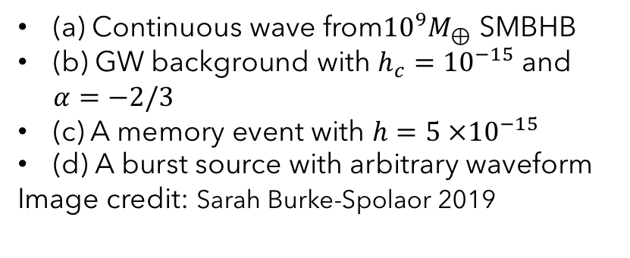
Pulsar Timing Arrays
Subtract timing model from pulse time of arrivals (TOAs)
$$t_{b}=t+\frac{DM}{v^{2}}+Δ_{R⊙}+Δ_{E⊙}+Δ_{S⊙}$$
Timing residuals
Sensitive to ultra-low frequency GWs ~${10}^{−9}−{10}^{−7}$ Hz
Current Organizations
European Pulsar Timing Array (EPTA)
Parkes Pulsar Timing Array (PPTA)
North American Nanohertz Observatory of Gravitational Wave (NANOGrav)
Indian Pulsar Timing Array (InPTA)
Chinese Pulsar Timing Array (CPTA)
International Pulsar Timing Array (IPTA)
(a) Continuous wave from${10}^{9}M_{⊕}$ SMBHB
(b) GW background with $h_{c}={10}^{−15}$ and $α=−2/3$
(c) A memory event with $h=5 ×{10}^{−15}$
(d) A burst source with arbitrary waveform
Image credit: Sarah Burke-Spolaor 2019

Slide 6
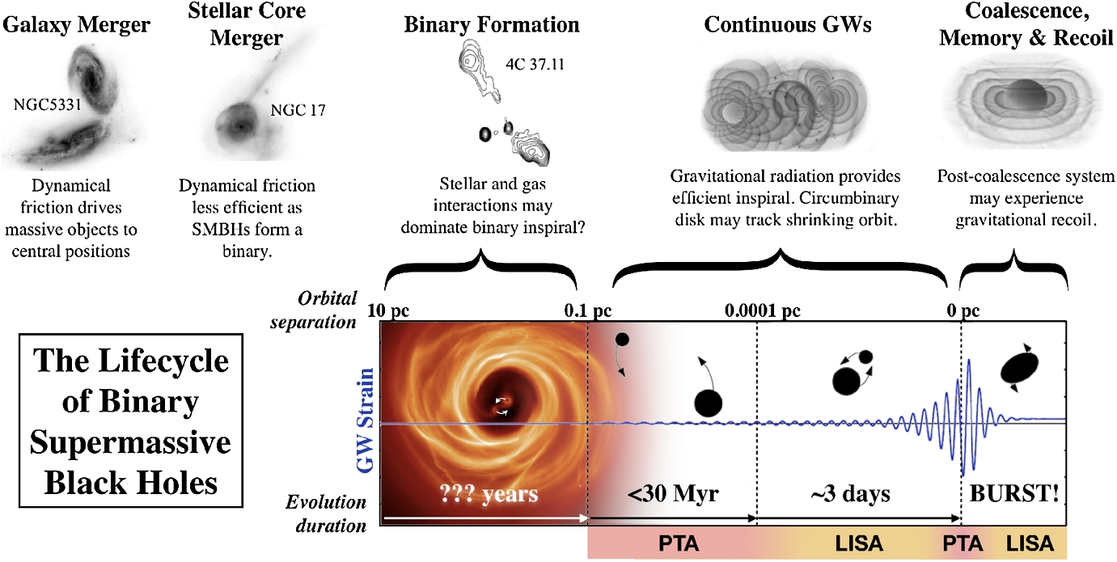
Super Massive Black Hole Binary
Image credit: Sarah Burke-Spolaor 2019

Slide 7

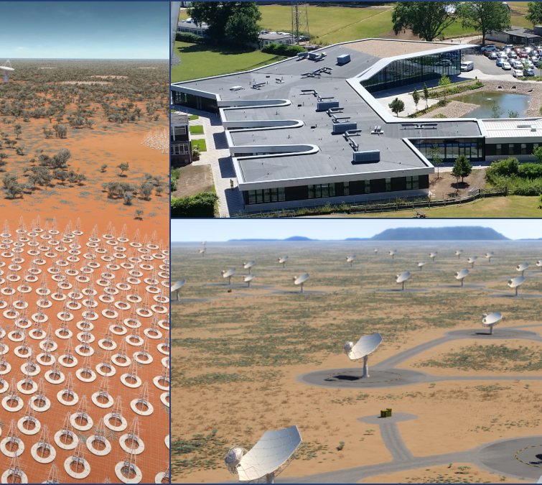
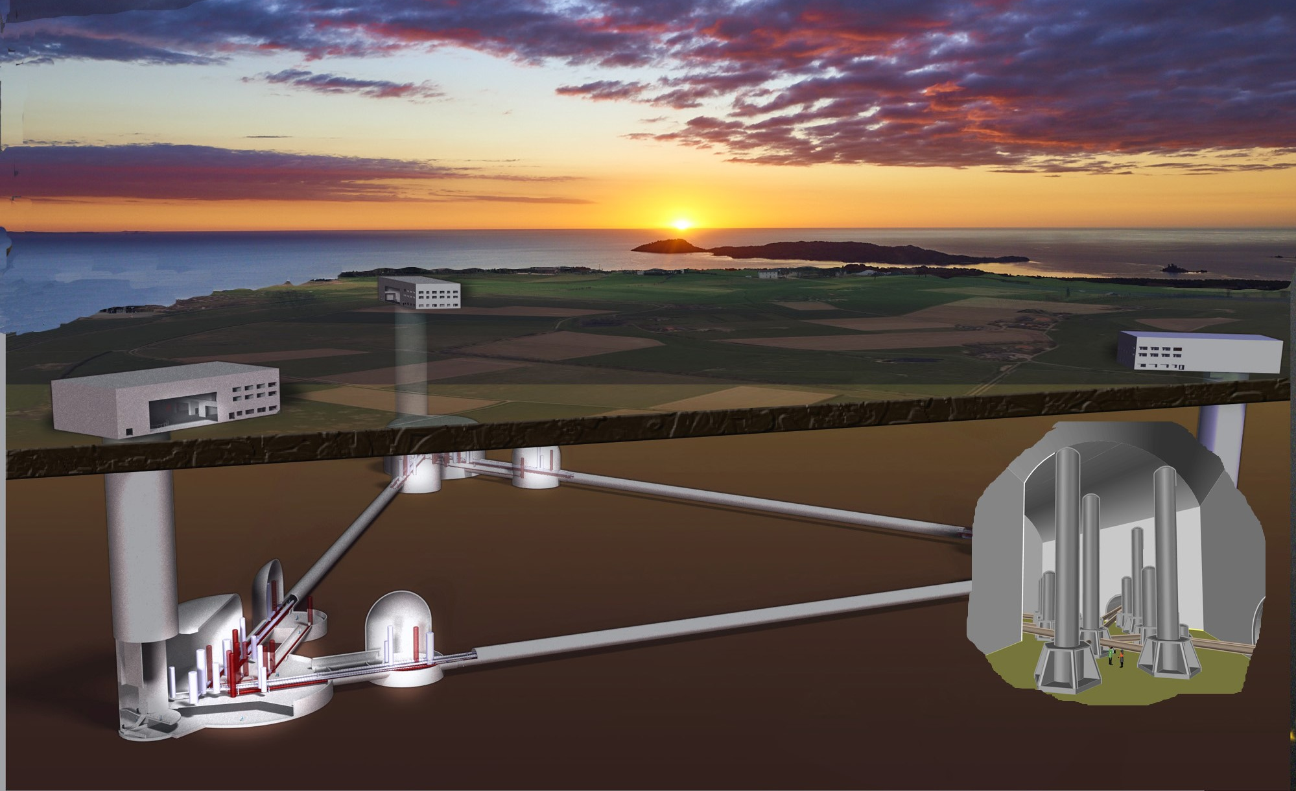
Future Instruments
Square Kilometer Array
Five-hundred-meter Aperture Spherical Telescope(FAST)
Einstein Telescope
Laser Interferometer Space Antenna(LISA)

Slide 8
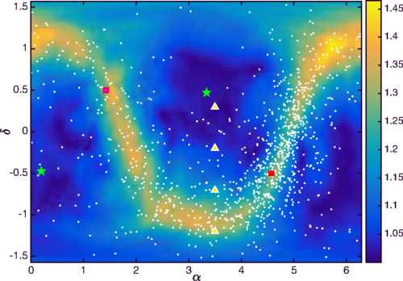
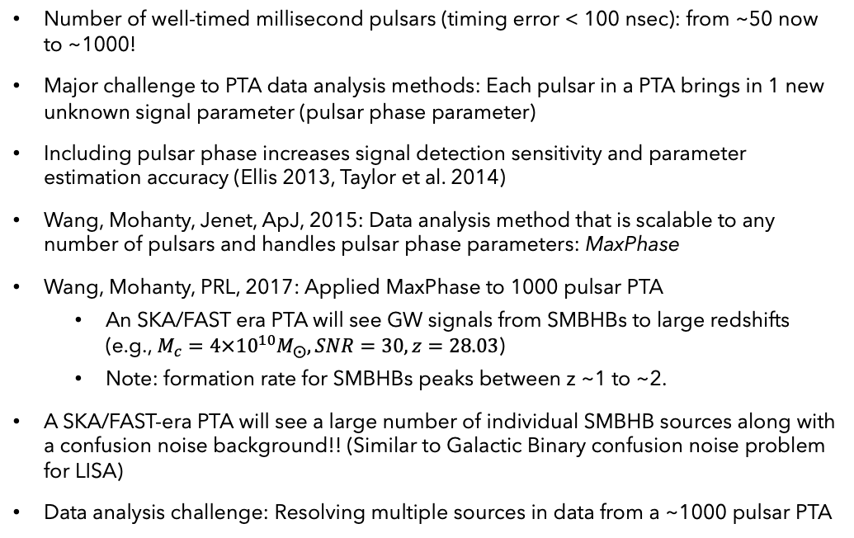
PTAs in SKA/FAST Era: Multi-source resolution
Number of well-timed millisecond pulsars (timing error < 100 nsec): from ~50 now to ~1000!
Major challenge to PTA data analysis methods: Each pulsar in a PTA brings in 1 new unknown signal parameter (pulsar phase parameter)
Including pulsar phase increases signal detection sensitivity and parameter estimation accuracy (Ellis 2013, Taylor et al. 2014)
Wang, Mohanty, Jenet, ApJ, 2015: Data analysis method that is scalable to any number of pulsars and handles pulsar phase parameters: MaxPhase
Wang, Mohanty, PRL, 2017: Applied MaxPhase to 1000 pulsar PTA
An SKA/FAST era PTA will see GW signals from SMBHBs to large redshifts (e.g., $M_{c}={4×10}^{10}M_{⨀}, SNR=30, z=28.03$)
Note: formation rate for SMBHBs peaks between z ~1 to ~2.
A SKA/FAST-era PTA will see a large number of individual SMBHB sources along with a confusion noise background!! (Similar to Galactic Binary confusion noise problem for LISA)
Data analysis challenge: Resolving multiple sources in data from a ~1000 pulsar PTA
Image credit: Y. Wang and S.D. Mohanty, PRL, 2017

Slide 9
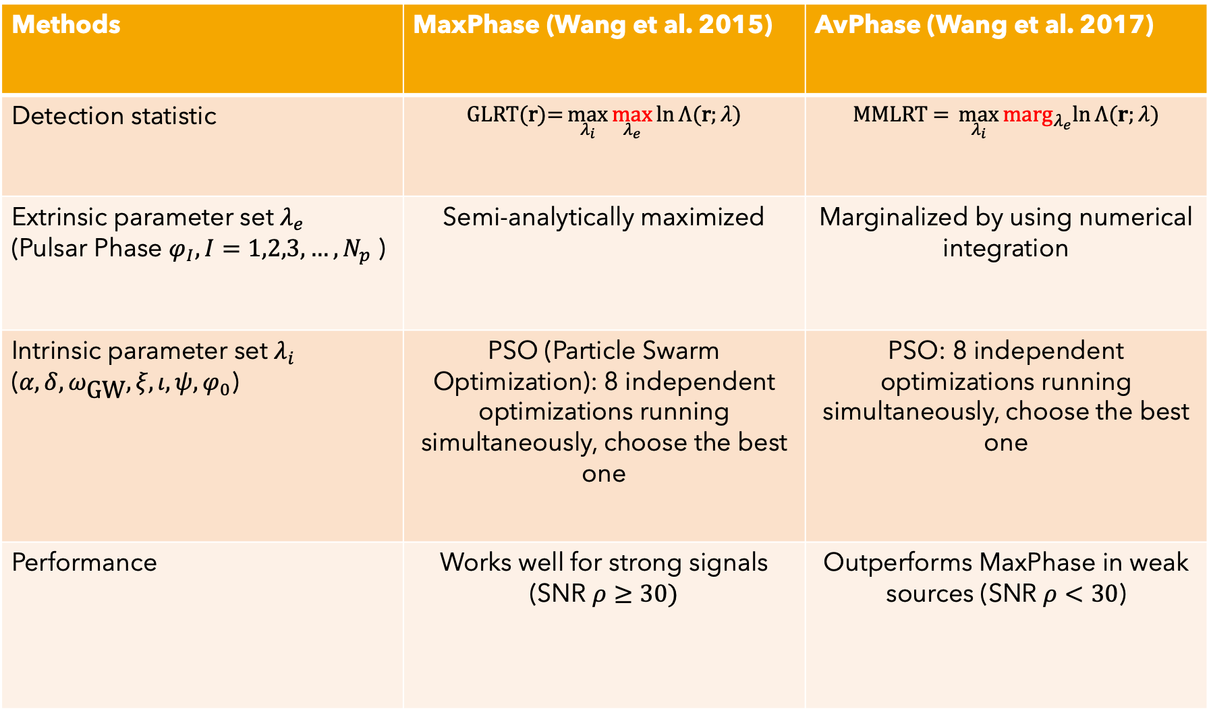
Methods | MaxPhase (Wang et al. 2015) | AvPhase (Wang et al. 2017)
Detection statistic | $$\text{GLRT}\text{(}\text{r}\text{)=}\max_{λ_{i}}{\max_{λ_{e}}{\ln{Λ(\text{r};λ)}}}$$ | $$\text{MMLRT}\text{ = }\max_{λ_{i}}{{\text{marg}}_{λ_{e}}ln⁡Λ(r;λ)}$$
Extrinsic parameter set $λ_{e}$ (Pulsar Phase $φ_{I}, I=1,2,3,…,N_{p}$ ) | Semi-analytically maximized | Marginalized by using numerical integration
Intrinsic parameter set $λ_{i}$ ($α,δ,ω_{\text{GW}},ξ,ι,ψ,φ_{0}$) | PSO (Particle Swarm Optimization): 8 independent optimizations running simultaneously, choose the best one | PSO: 8 independent optimizations running simultaneously, choose the best one
Performance | Works well for strong signals (SNR $ρ≥30)$ | Outperforms MaxPhase in weak sources (SNR $ρ<30$)

Slide 10
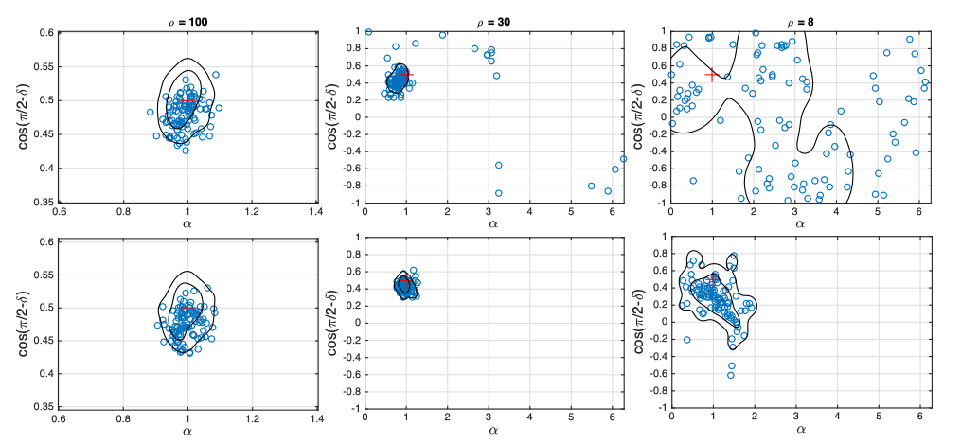
Performance
MaxPhase
AvPhase
Estimated sky locations(blue circles) obtained from MaxPhase(top row) and AvPhase(bottom row). Image taken from Y. Wang, S.D. Mohanty and Y.-Q. Qian 2017

Slide 11
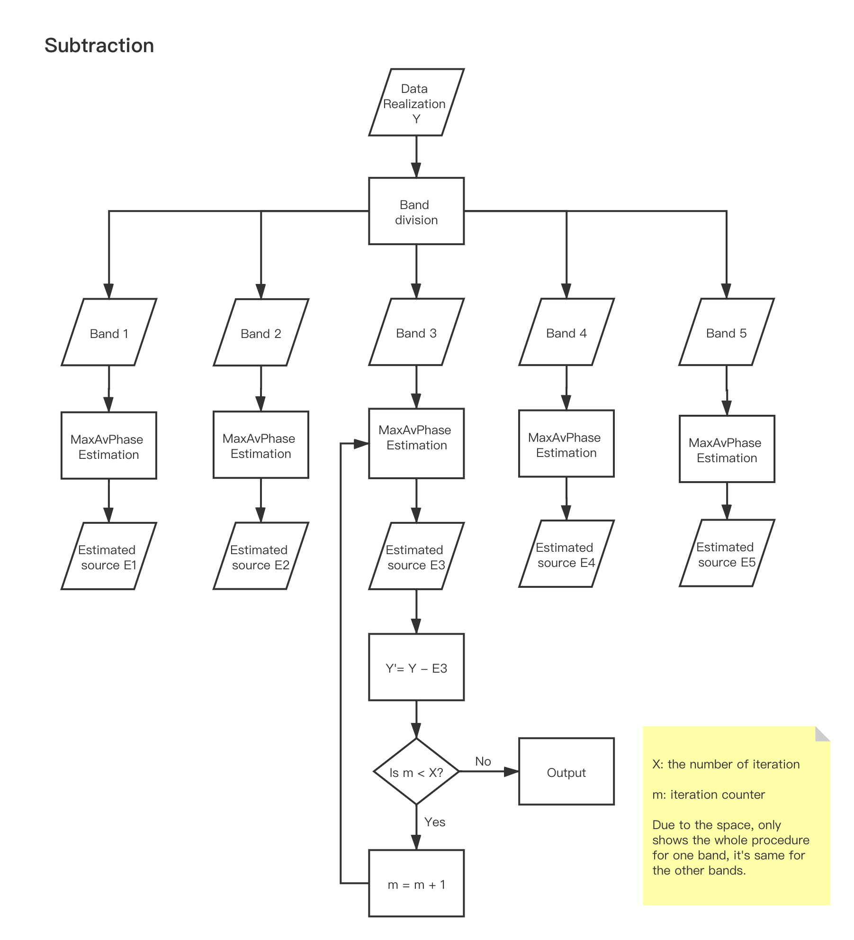
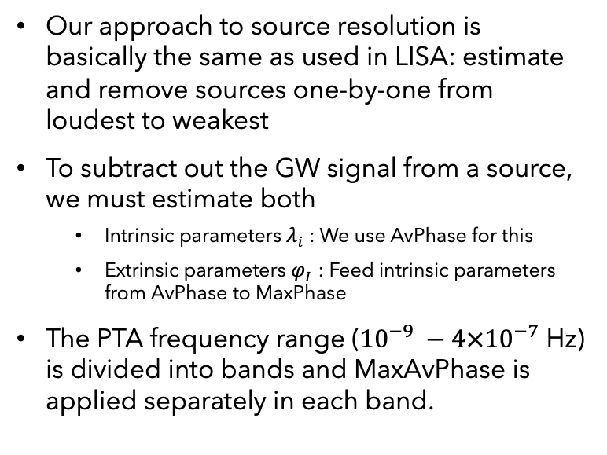
MaxAvPhase: a combination of MaxPhase & AvPhase
Our approach to source resolution is basically the same as used in LISA: estimate and remove sources one-by-one from loudest to weakest
To subtract out the GW signal from a source, we must estimate both
Intrinsic parameters $λ_{i}$: We use AvPhase for this
Extrinsic parameters $φ_{I}$ : Feed intrinsic parameters from AvPhase to MaxPhase
The PTA frequency range (${10}^{−9} −{4×10}^{−7}$ Hz) is divided into bands and MaxAvPhase is applied separately in each band.

Slide 12
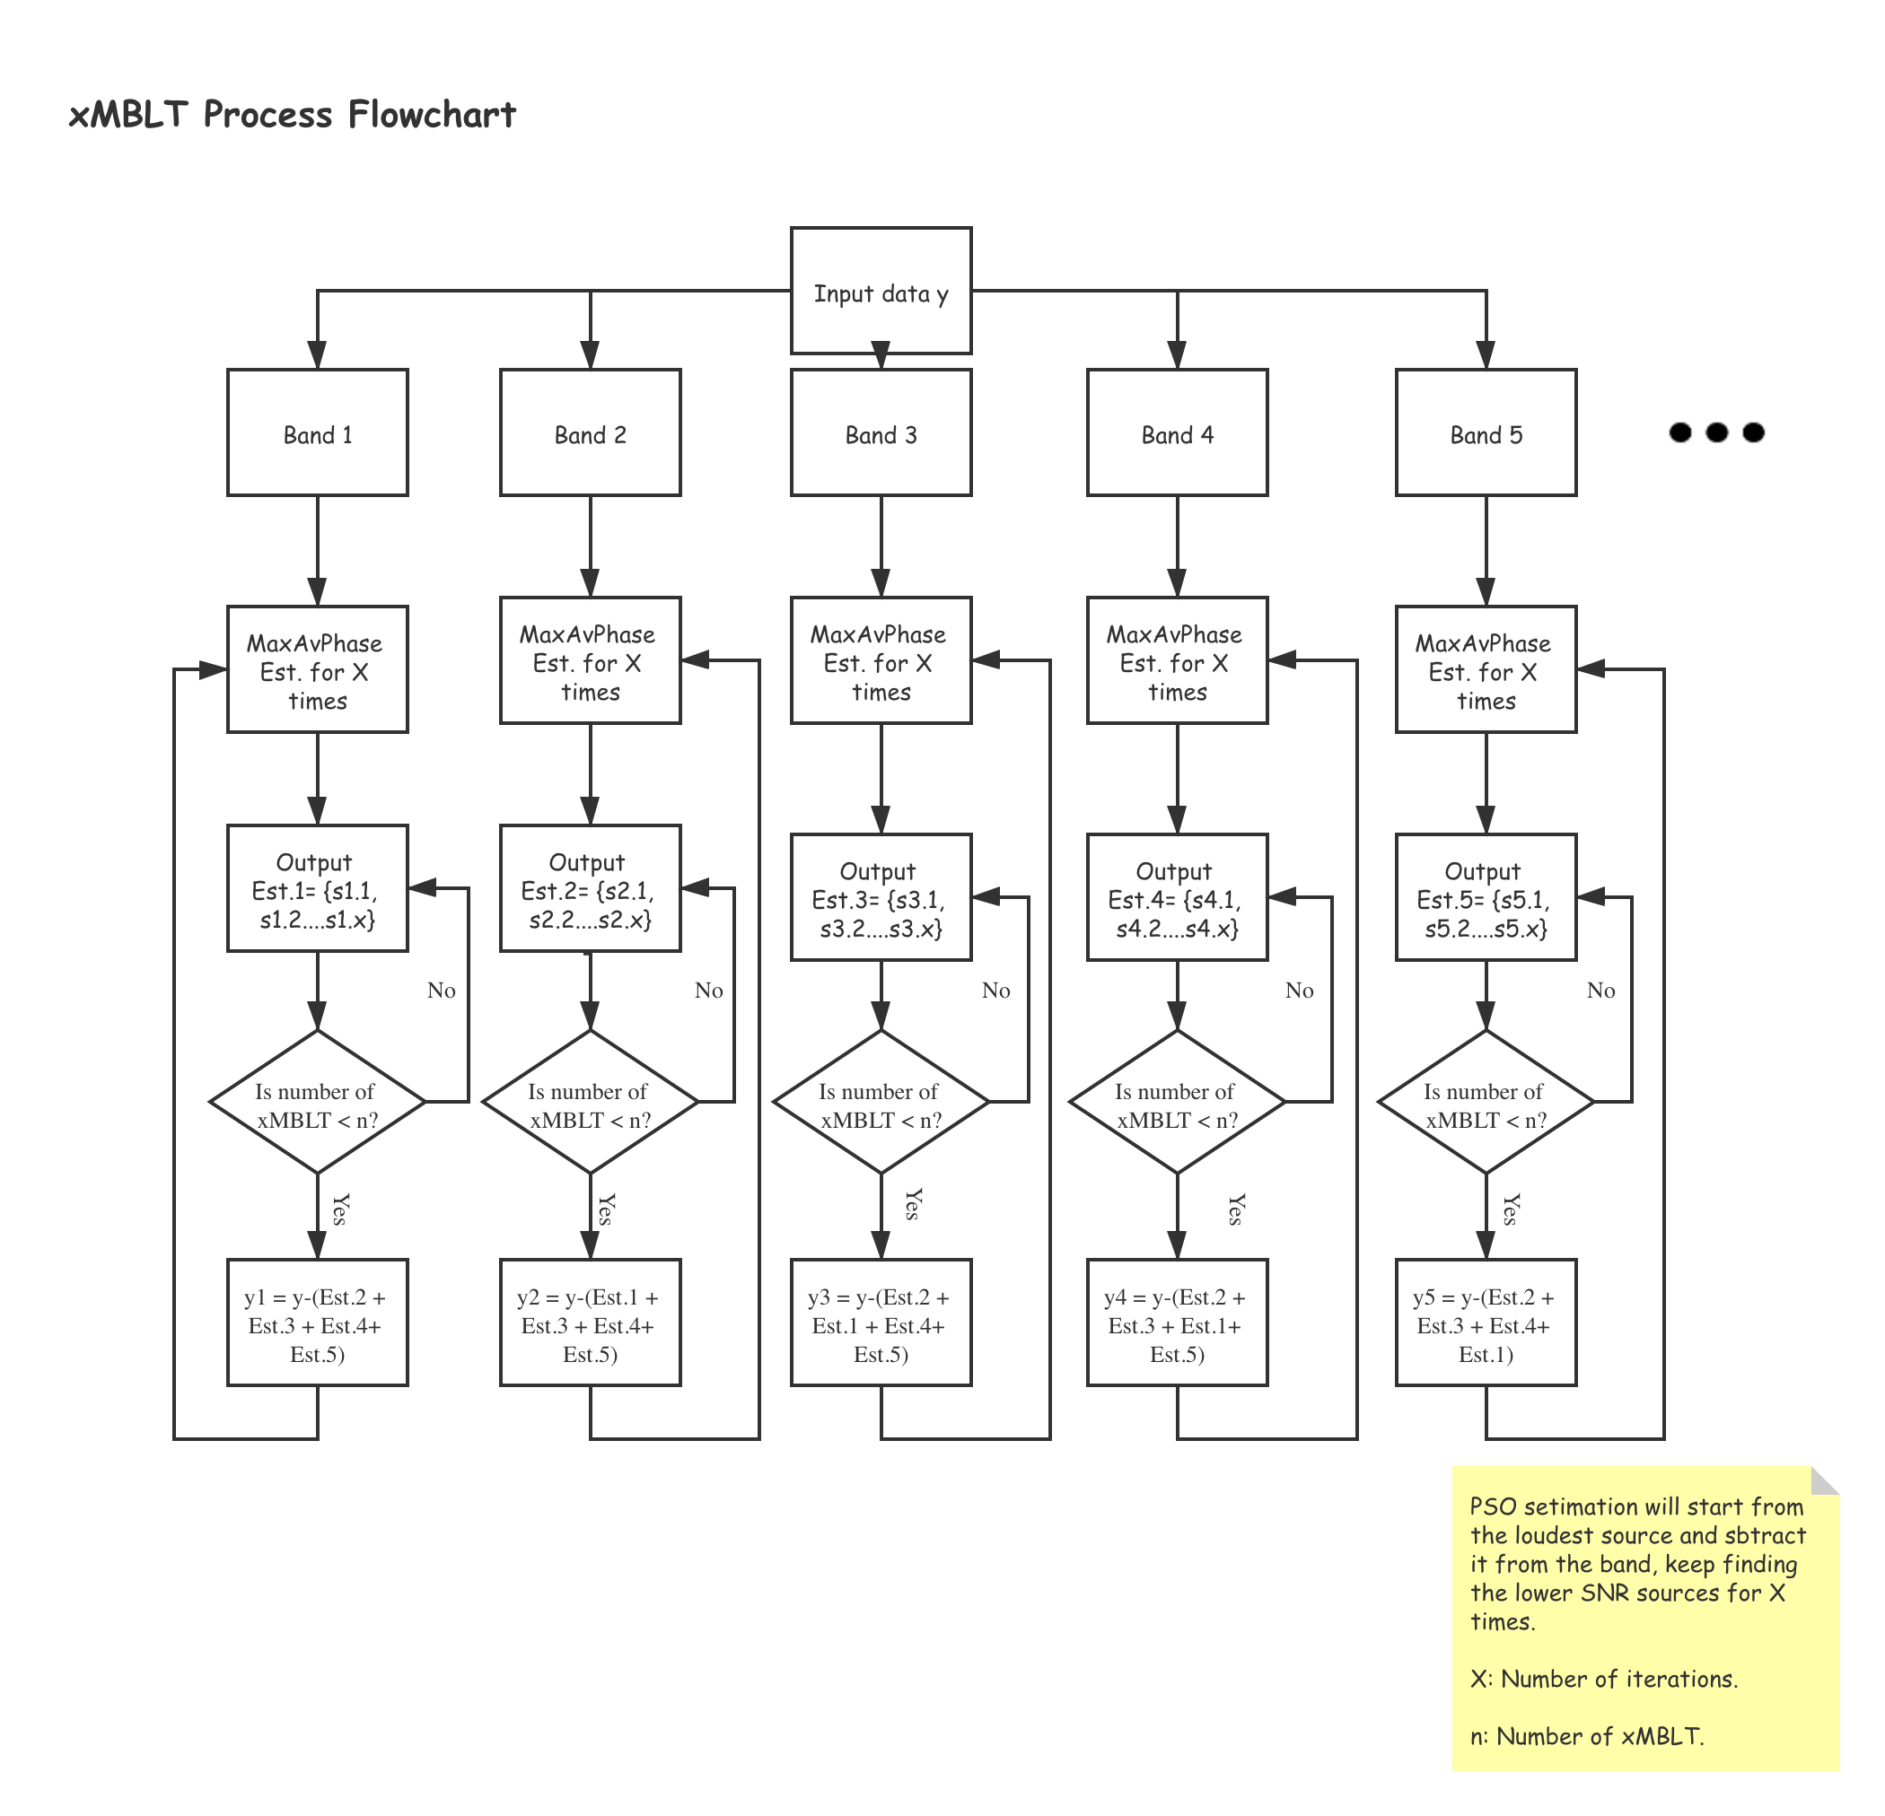
xMBLT(cross-band MBLT)
Power from signals in one band can leak into neighboring bands and affect the estimation of sources
We use the approach proposed in S. Mohanty, CQG, 2002, for removing line noise in data from ground-based GW detectors (MBLT method)
xMBLT: Basic idea
Stage 1: Estimate all sources in band 1, band 2, band 3, ….
Stage 2: Remove sources from band 1 & 3 but not band 2
Stage 3: Estimate all sources in band 2
(Apply the above to each band)

Slide 13
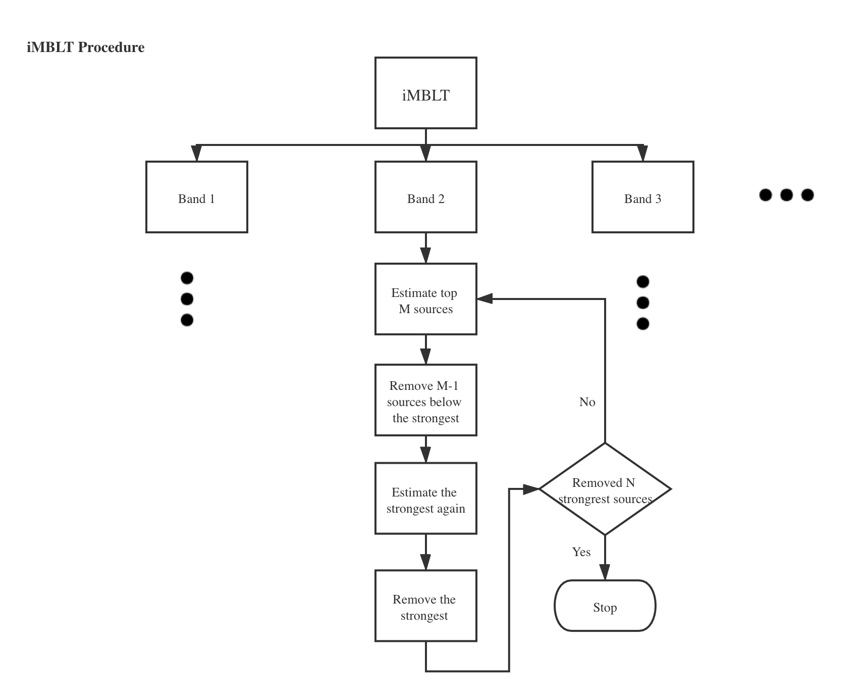
iMBLT(in-band MBLT)
Power from weaker signals within one band can affect the estimation of stronger sources in the same band
iMBLT: Basic idea
Stage 1: Estimate top M sources in 1 band ….
Stage 2: Remove all M-1 sources below strongest
Stage 3: Estimate strongest source again
Stage 4: Remove strongest source
Repeat …
(Apply the above to each band)

Slide 14
Simulation Configuration
PTA: Selected 1000 simulated MSPs (R. SMITS 2009) in SKA era which are within 3kpc from us
Image credit: Y. Wang and S.D. Mohanty, PRL, 2017
SMBHBs:
Uniform distribution in sky locations, inclination angle, polarization, initial phase and the distance;
while log-uniform distribution for the frequency and chirp mass.
Figure only shows 4 SMBHB sources. We add hundreds of SMBHBs.

Slide 15
Results: 100 GW sources, 5 bands, 10 iterations
Loudest sources got estimated in band 1 and band 2
Many spurious sources in low SNR area close to the edges between different bands
Not approaching the SNR floor
Estimated twice

Slide 16
Results: 100 GW sources, 5 bands, 10 ite. with xMBLT
Loudest sources got estimated correctly
Spurious sources got suppressed
Approaching the SNR floor
We use some constrains to re-assign the source

Slide 17
Results: 200 GW sources, 5 bands 10 ite.
Spurious sources near band edges and have relatively high SNR
Source got resolved twice near band edge
Sources near band edge will induce spurious sources
Number of estimated sources in band 1 indicates we might need more iterations
Estimated twice again

Slide 18
Results: 200 GW sources, 5 shifted bands, and 20 ite.
Shifted band edges to avoid sources
Spurious sources got suppressed
Approaching the SNR floor
Fixed
Lots of spurious sources
lowered
lowered
Band 3 doesn’t converge
lowered

Slide 19
Results: 200 GW sources, 5 shifted bands, and 20 ite. with xMBLT
Spurious reduced substantially
2nd loudest source estimated worse
Find one more source
Approaching SNR floor
Get worse
Gone!
lowered
lowered
Get one more
Band 3 converges
lowered

Slide 20
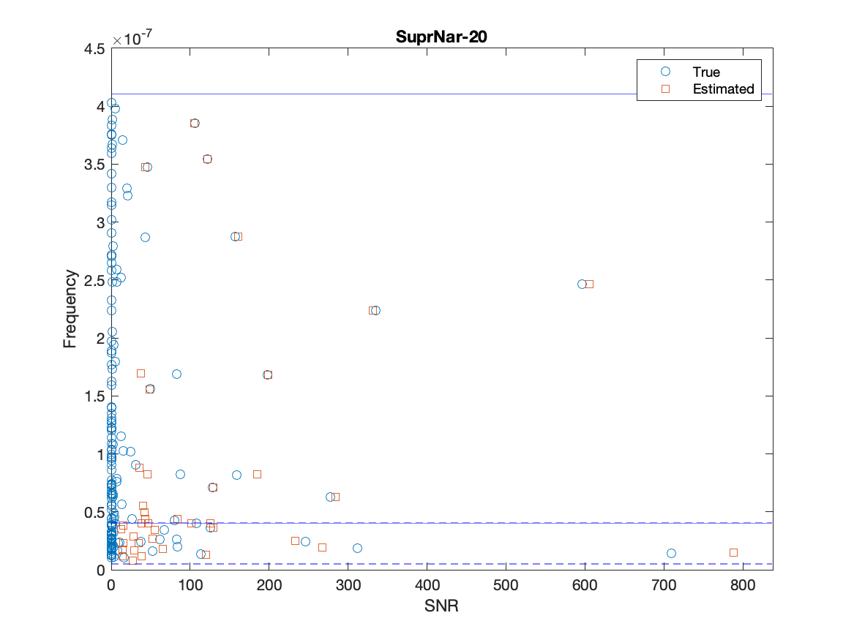
Initial results
Divided into two unequal bands
MaxAvPhase 20 times in each band
Large number of Spurious sources
Edge effects near band edges

Slide 21
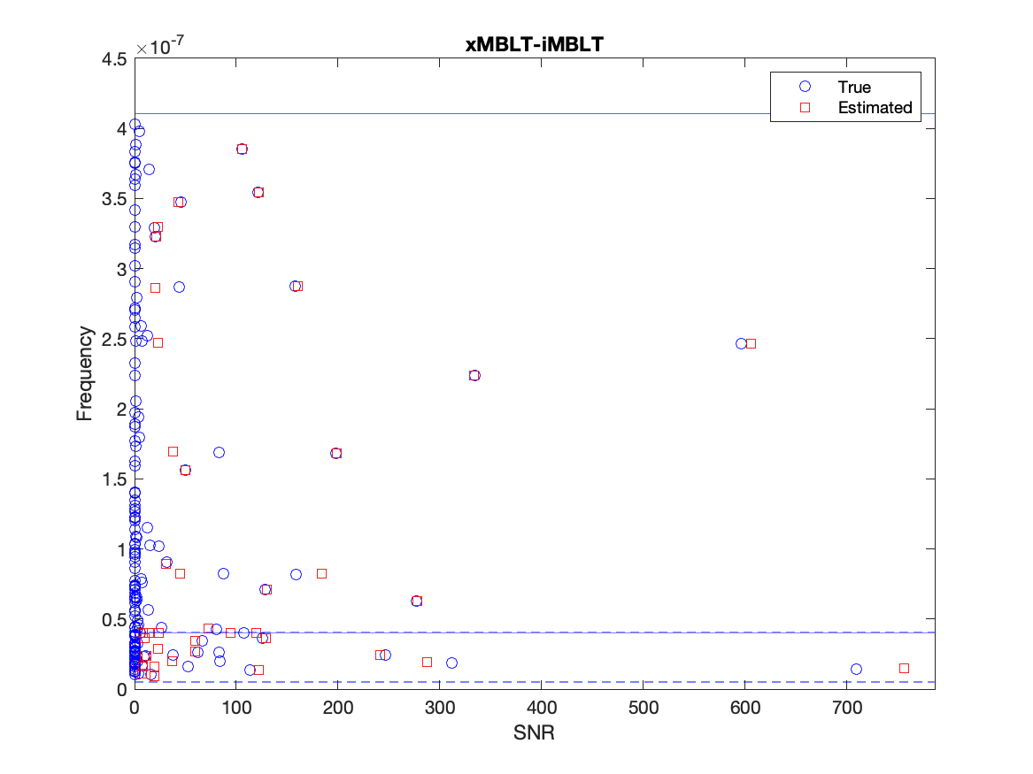
Best strategy so far
iMBLT after xMBLT:
Based on initial results
Apply xMBLT to each band
Apply iMBLT in each band

Slide 22
Using NMTC to cut off spurious sources
NMTC: a modified correlation coefficient suitable for PTAs with large number of pulsars.
Basic idea:
Use NMTC between estimated sources from two different methods applied to the same data
Spurious estimated sources are unlikely to appear with the same parameters (hence high NMTC) in two sufficiently independent methods
By correlating iMBLT-after-xMBLT (our best strategy so far) with the other two methods (initial or xMBLT), we can use the value of NMTC to cut off some spurious sources
We use 0.7 as the threshold for identification

Slide 23
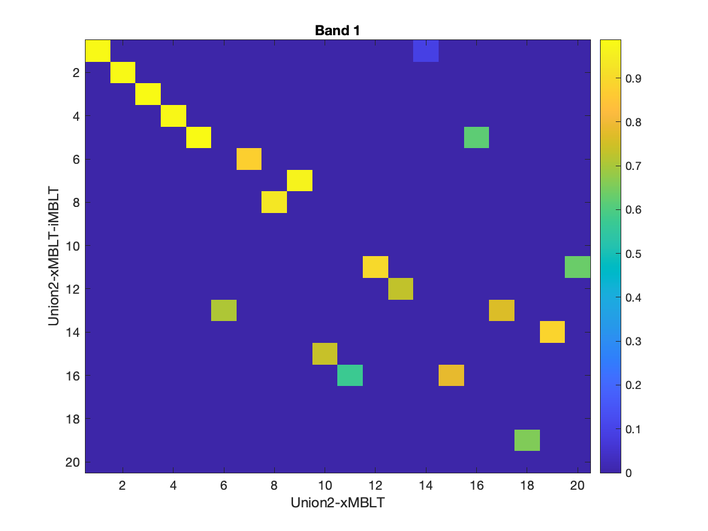
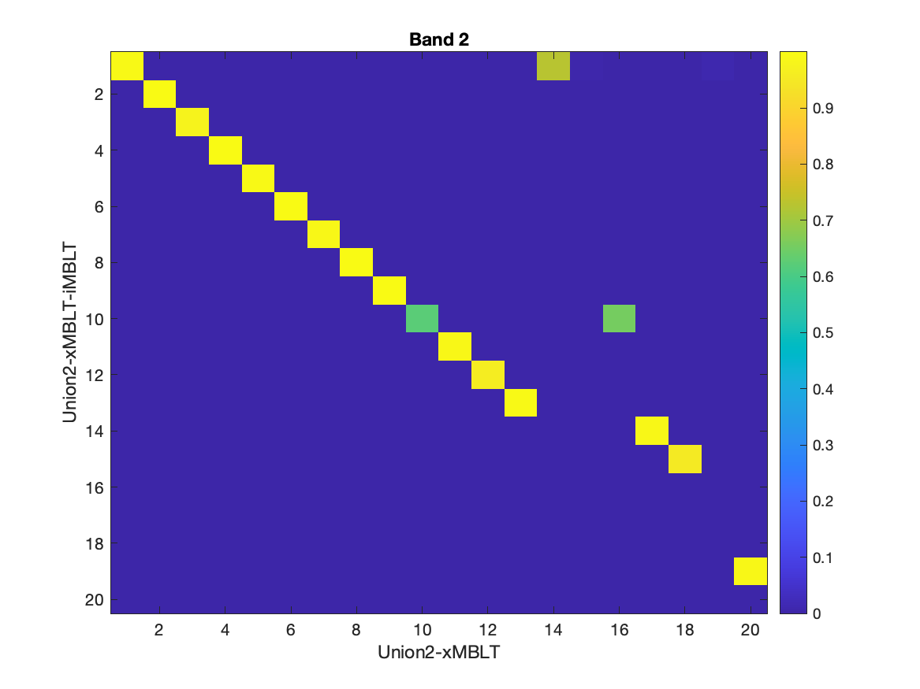
xMBLT vs. iMBLT-after-xMBLT

Slide 24
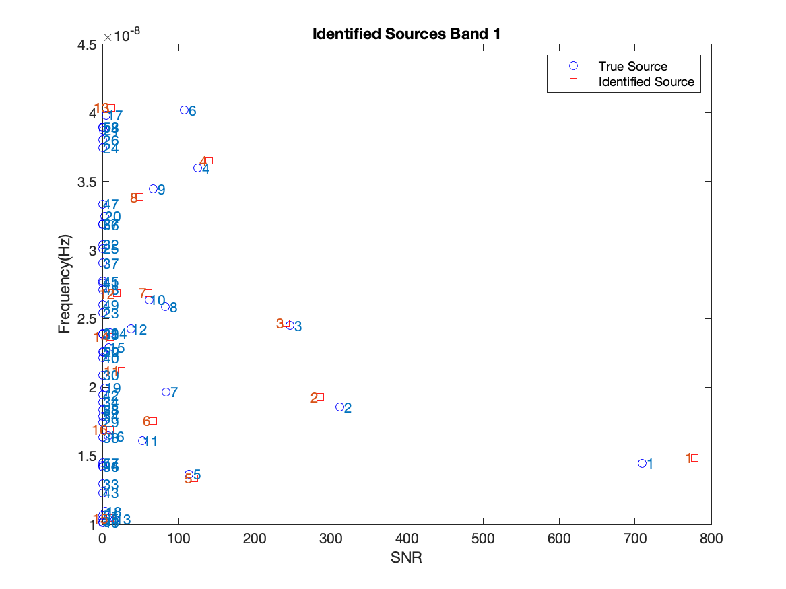
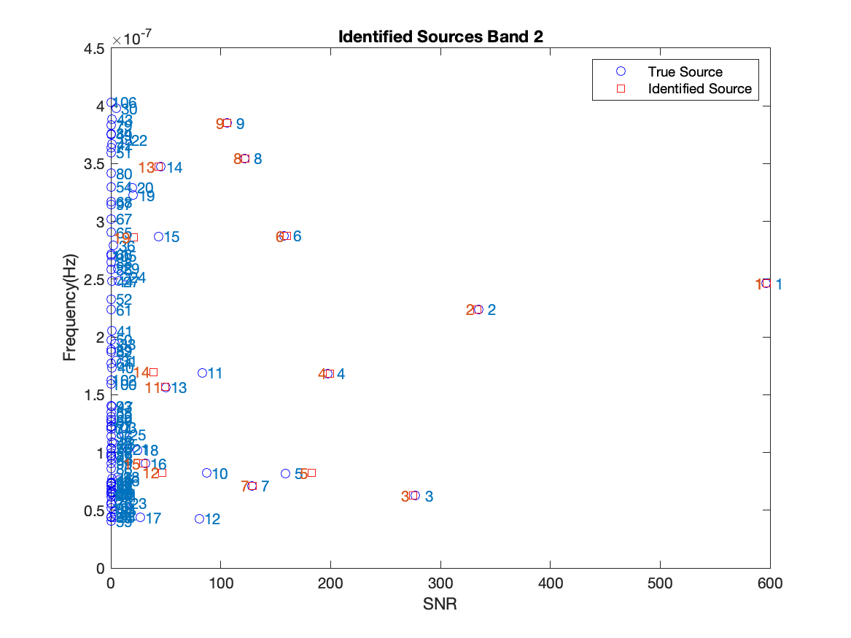
Identified sources using threshold = 0.7

Slide 25
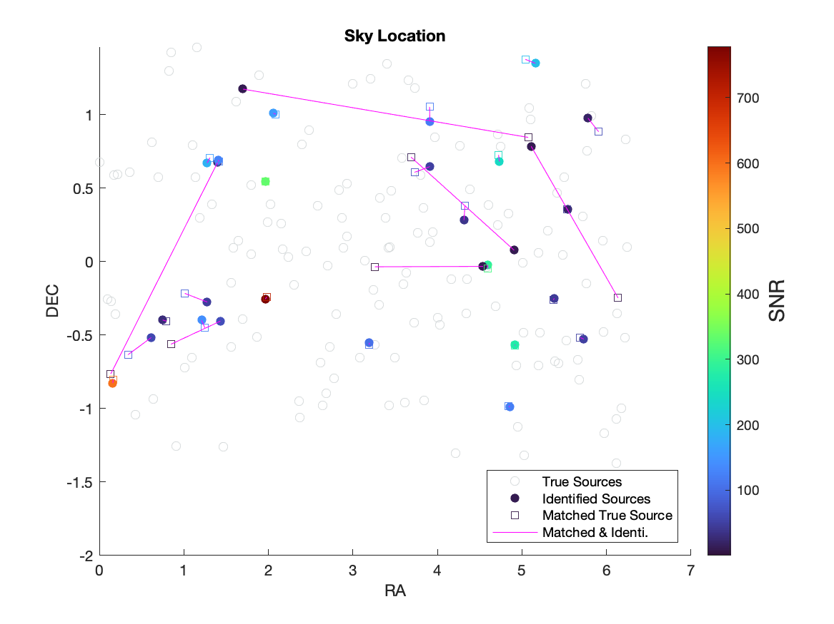
Sky location for identified sources

Slide 26
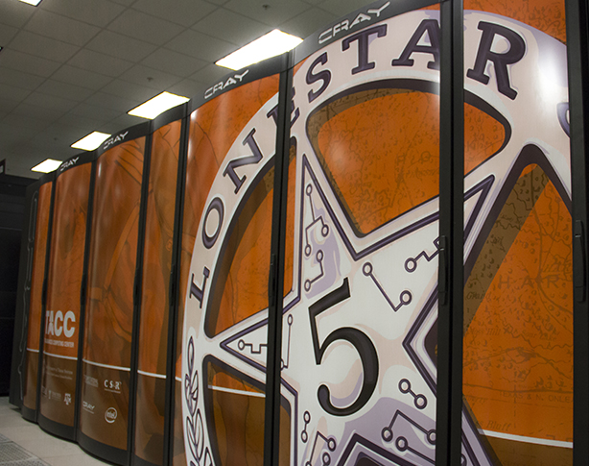
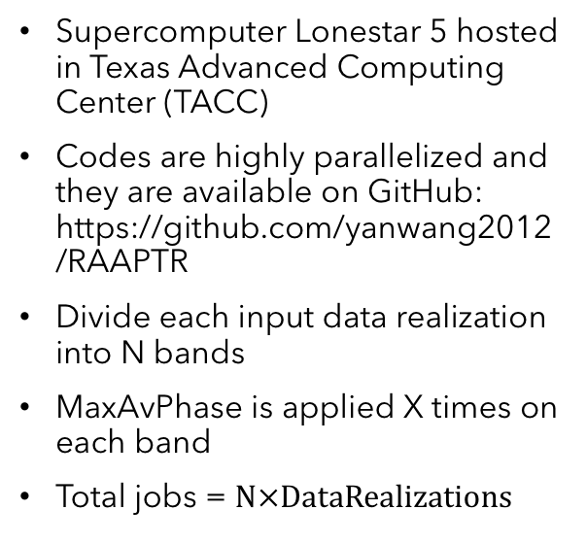
High Performance Computing
Supercomputer Lonestar 5 hosted in Texas Advanced Computing Center (TACC)
Codes are highly parallelized and they are available on GitHub: https://github.com/yanwang2012/RAAPTR
Divide each input data realization into N bands
MaxAvPhase is applied X times on each band
Total jobs = $\text{N}×\text{DataRealizations}$

Slide 27
Computational cost
For a single MaxAvPhase, the running time is around 2 hours.
For 100 sources divided into 5 bands with 10 iterations in each band, total 500 jobs use up to 166 nodes (24 cores/node), it needs 12 – 13 hours, the same configuration for 200 sources requires around 18 hours, depends on how busy the supercomputer is.
Because of the code is highly parallelized, the number of bands will not affect the running time.
iMBLT increases computational cost dramatically.

Slide 28
Summary & Conclusion
Methods developed for resolving multiple GW sources
No approximation of dropping pulsar phases (e.g., Babak & Sesana 2012 )
Can handle SKA/FAST era PTA with large number of pulsars
New features:
xMBLT, iMBLT
Cross-correlation analysis between independent methods to eliminate spurious sources.
Promising results: PTA multi-source resolution problem can be solved
We are able to resolve sources from very loud (SNR~200) to almost noise level (~15) given a population of 100 sources
Limitations and Future work:
Realistic source population
Statistical characterization of performance on multiple data realizations (in progress)
Refinement of the method continues (e.g., Dithering of band edges to catch duplicated sources in xMBLT)

Slide 29

Thank you !
TO BE CONTINUED….

